Slide 1
Performance of HotSpot with various Flags
Boyuan Feng

Slide 2
Overview
JVM is the specification on java virtual machine about the data structure, API, compiling, and so on.
HotSpot is an implementation of the JVM concept
We select five flags to tune the performance of program
To evaluate the effect of flags under different workload, eleven programs were selected
Through experiments, we show the difference in performance introduced by interpretation, compilation, and garbage collection.

Slide 3
Selected Flags
Default: HotSpot will perform 10,000 interpreted method invocations to gather information for efficient compilation.
-Xbatch: Disable background compilation so that compilation of all methods proceeds as a foreground task until completed
-XX:+AggressiveOpts: Enable the use of aggressive performance optimization features
-Xint: Run the application in interpreted-only mode and compilation to native code is disabled
-Xcomp: Force the compilation of methods on first invocation
-Xnoclassgc: Disable garbage collection of classes to save some GC time.

Slide 4
Selected Programs
sqrt() vs pow(x, 0.5): sqrt() focuses on square root while pow can do much more things. Thus we expect sqrt to perform better than pow.
Binary-trees: Fully create perfect binary trees. This code will introduce a heavy workload on memory.
Fasta: Randomly generate a DNA sequence.
Reverse-complement: Read in a DNA sequence and write its complement to disk. This code will introduce heavy workload on IO.
And six other tasks.

Slide 5
Experimental Setting
The performance is measured by running time using “System.currentTimeMillis()”
To eliminate the effect of randomness, every combination of program and flag is measured for 5 times and the average running time is reported
The performance is measured on a quad-core 2.2 GHz Intel i7-6560U CPU with 8GB of RAM and a 220GB SSD

Slide 6
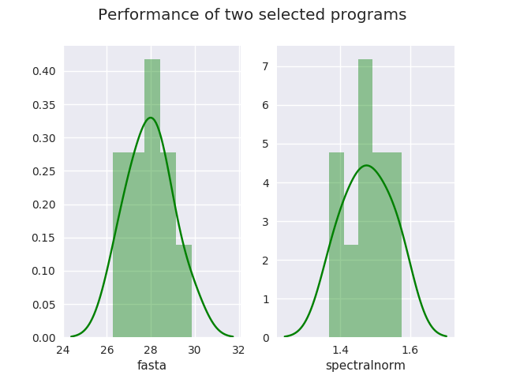
Experiment 1
Observation:
Performance of same program on same machine may vary a lot. 4 seconds for fasta and 0.2 seconds for spectralnorm.
For each program, the error rate is around 15%.

Slide 7
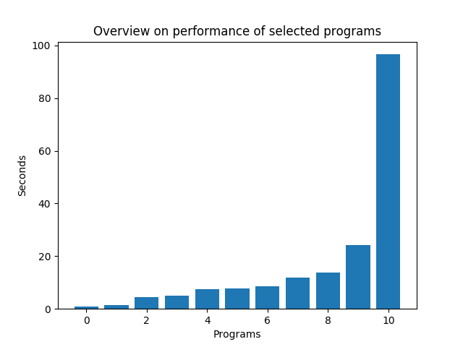
Experiment 2
Programs with various running time are selected to compare the flags better.

Slide 8
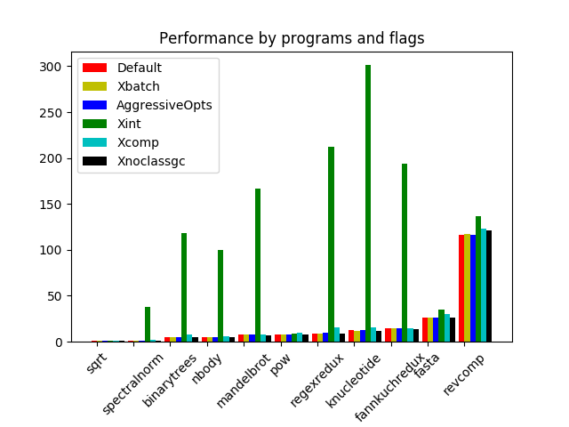
Experiment 3
The most significant result is the green line, which stands for only interpretation.
To compare other flags better, we are going to delete performance for xint and only display results for other flags.

Slide 9
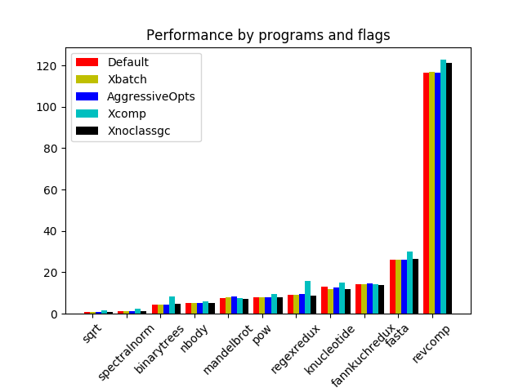
Experiment 4
We find that the blue line becomes higher than others frequently, which represents “force the compilation of methods on first invocation”.
Considering the variance of measurement, other flags show similar performance on selected programs.
Also note that pow is much slower than sqrt, which focus on square root.

